Slide 1

Mini project Details
Project Name: Customer Churn Prediction
Submitted by –Sajal Gupta
Sem-5th
University Rollno-2018682
Section-E
Student Id -20011919

Slide 2
Problem Statement : As in this fast-growing world, the business/company are in a race of getting lots or customers to use their products . But as customer are migrating from one to another company where they get satisfaction. Develop a machine learning model which can predict that a customer can churn or not.
Approach :
Here we are developing a supervised machine learning model on the Telcom industry data set and train the model on various aspects by using various algorithms :
1. Decision Tree – which gives accuracy of 93.43%.
2. Random forest – which gives accuracy of 95.34%.

Slide 3
What is need of this project
To increase the business model of any sector by CUSTOMER Retention .
If we know the ratio of churners to nonchurners then we can easily take some steps to stop the mobilization of the customers
Which is basic requirement of any sector

Slide 4
Steps to be followed in this project
1. Getting the correct dataset.
2. Data cleaning
3. Exploratory Data Analysis
4. Developing the model
5. Training the model
6. Testing the model
7. Designing the front end
8. Modelling the model with front-end
9. Designing a functional website
10. Deployment

Slide 5
Working of model
1 Input
2 Take to model
3 Analyse
4 Predict
5 Generate Output
6 Display result

Slide 6

Languages used in frontend
1 HTML
2 CSS
3 Bootstrap
4 JavaScript
5 Flask

Slide 7
Languages and Library used in Back end
1. Python
NumPy
Pandas
Seaborn
Matplotlib
Sklearn
Random forest classifier
Decision tree classifier

Slide 8
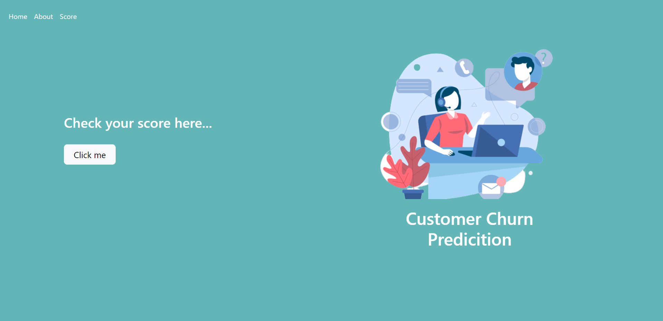
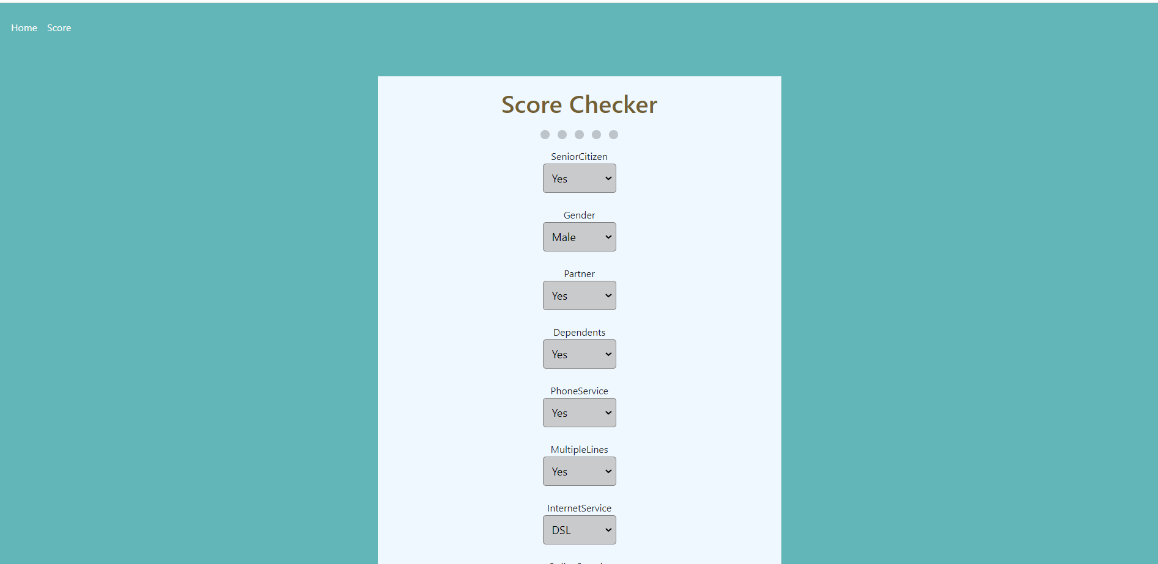
Front end of the project
Home page
Score page

Slide 9
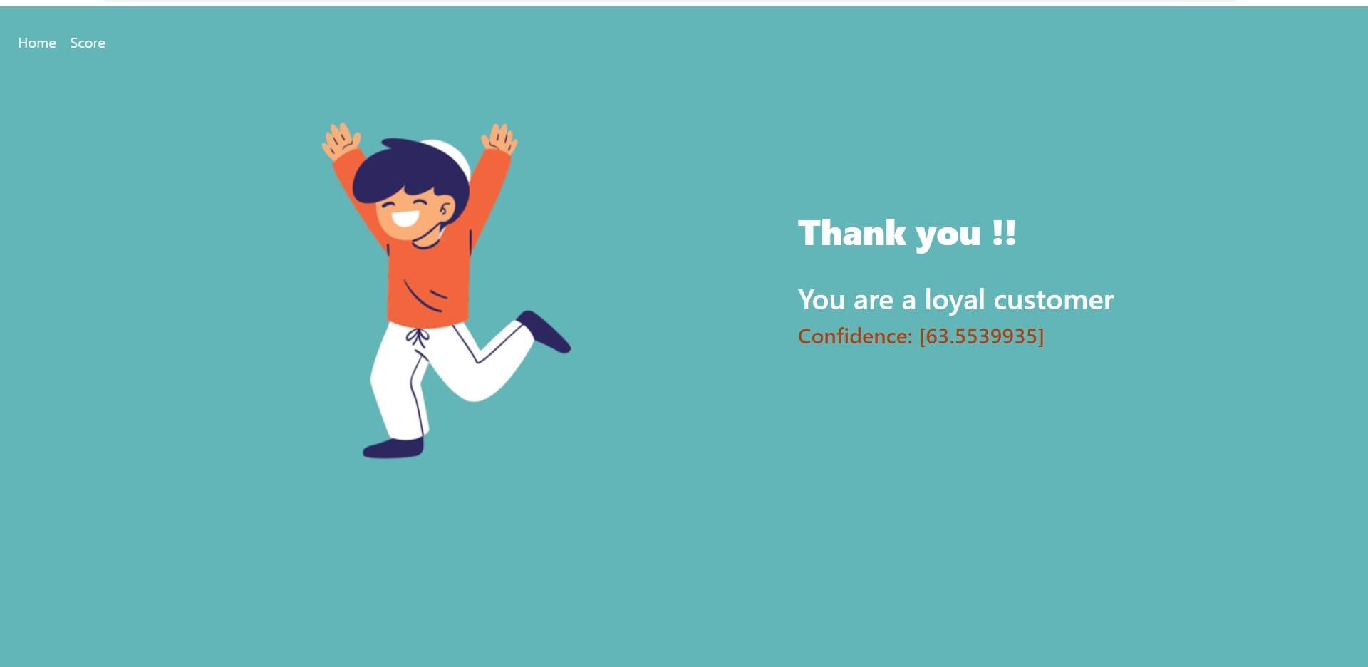
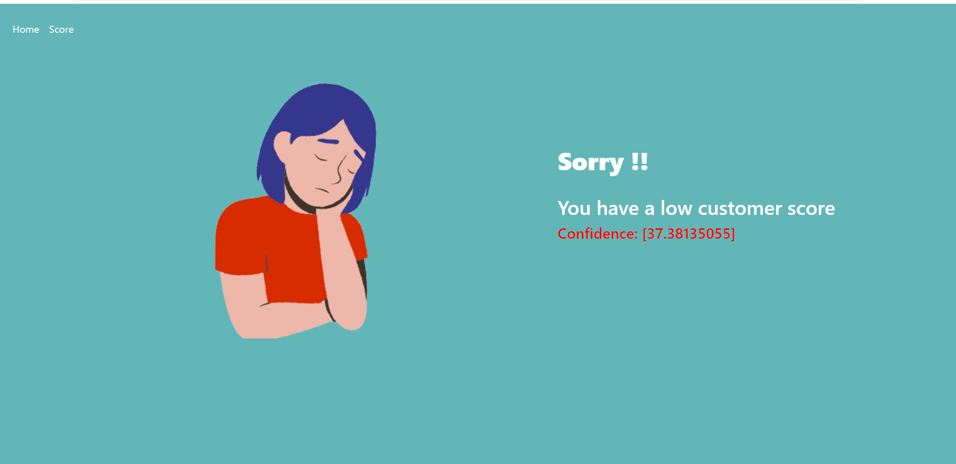
Front end --
Success page
Sorry page

Slide 10

Thank you !!

